Slide 1
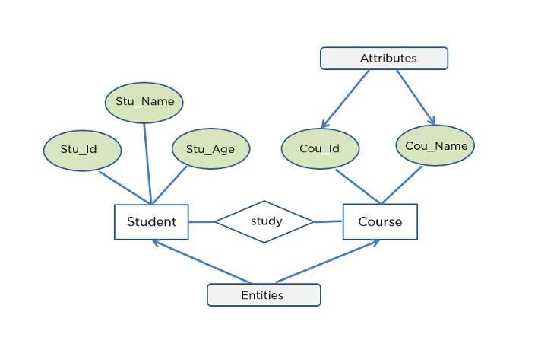
ER-Model of College student

Slide 2
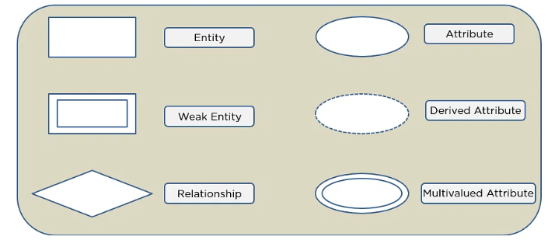
Symbols Used in ER Diagrams
Rectangles: This Entity Relationship Diagram symbol represents entity types
Ellipses: This symbol represents attributes
Diamonds: This symbol represents relationship types
Lines: It links attributes to entity types and entity types with other relationship types
Primary key: Here, it underlines the attributes
Double Ellipses: Represents multi-valued attributes

Slide 3
Exercise Based on ER-Model
Consider the ER diagram shown in the figure for a part of a Bank database. Each bank can have multiple branch and each branch can have multiple account and loans.

Slide 4
Address
NAME
Address
Branch no.
1
BRANCHES
N
Bank Branch
CODE
BANK
N
1
N
Accts
Loans
Acct. No.
Loan No.
Type
Balance
Account
Type
M
Amount
Loan
Account-Customer relationship
SSN
Name
N
L-C
Address
CUSTOMER
Phone

Slide 5
Q1. List the (nonweak) entity type in the ER-diagram.
Q2. Is there a weak entity type ? If so, give its name , partial key, and identifying relationship.
Q3. What constraints do the partial key and the identifying relationship of the weak entity specify in the diagram
Q4. List the name of all relationship types, and specify the (min, max) constraints on each participation of an entity type in a relationship type. Justify your choice.
Q5. List concisely the user requirement that led to this ER schema design.

Slide 6
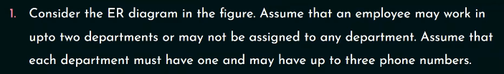
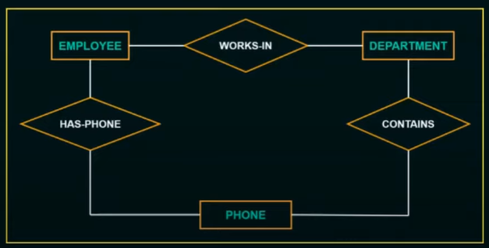
Exercise 2

Slide 7
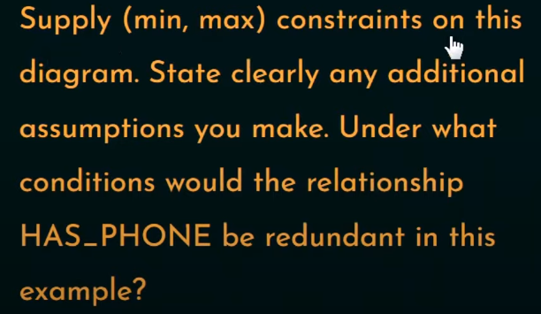
Q1.

Slide 8
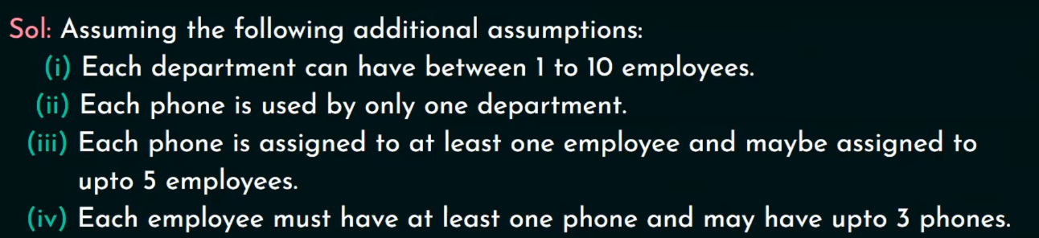
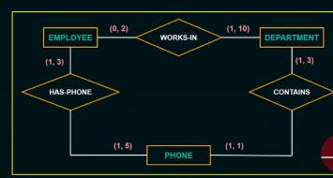
Answer

Slide 9

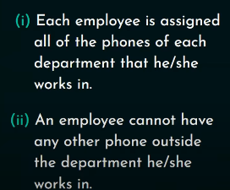
As per 2nd statement solution is :-

Slide 10
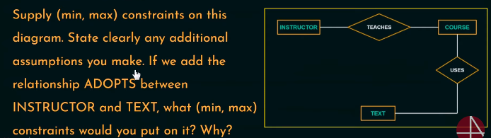
Question 2.

Slide 11
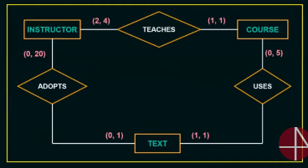
Answers

Slide 12

End.

